Slide 1

SOFTWARE INCUBATOR

Slide 2
What is Game Development?

Slide 3
Why Game Development?

Slide 4
<HTML>
Notes:
Are you all familier with html. Which is hypertext markup language . So here question arise what a use of html in game development- answer is it provide structure to your page

Slide 5
What is HTML?
HyperText Markup Language
Language for creating web pages and web applications.
It tells the browser how to display web page.
Latest Version is HTML5.
Notes:
Other work done by html- display web pages and web application . Do you know latest version of html –which is html5

Slide 6
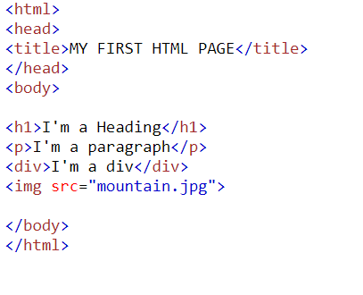




HTML Tags

Slide 7
Tags v/s Attributes
<Tag>
HTML Elements are written with a start tag, an end tag with content between the two.
Syntax: <tag>content</tag>
Example: <head>, <h2>, <div>, </head>, </h2>,</div>
Attributes
Attributes provide additional information about an element. Attributes are always specified in the start tag.
Syntax: <tag attribute = “value”>
Example: style, href, alt, id, class etc..

Slide 8
A few more Tags
<img src=”image.jpg” alt=”This is an image” />
<a href=”www.silive.in”>This is a link</a>
<input type=”text” placeholder=”This is a textbox” />
<input type=”submit” value=”Click Here” />

Slide 9
CSS

Slide 10
What is CSS?
Cascading Style Sheets
Used to control the style of a web document in a simple and easy way.
Latest version is CSS 3
Notes:
Here chocolate que.. So wait for some time- type of css

Slide 11
Types of CSS
Inline CSS
Internal CSS
External CSS

Slide 12
Inline CSS
<body>
<h1 style="color: blue;">Hello</h1>
</body>
Hello

Slide 13
Internal CSS
<head>
<style>
body { background-color : gray; }
h1 { color : black ; }
p { color : red ; }
</style>
</head>
<body>
<h1>Hello</h1>
<p>World</p>
</body>
Hello
World

Slide 14
External CSS
<head>
<link rel="stylesheet" href="styles.css">
</head>
<body>
<h1>This is a heading</h1>
</body>
styles.css
body { background-color: gray; }
h1 { color: red; }
This is a heading

Slide 15
Class & ID
<style>
.city {
background-color: red;
}
#id {
color: blue;
}
</style>
<body>
<h2 class="city">Hello</h2>
<p id=”para”>World</p>
<h2 class="city">John</h2>
</body>
Hello
World
John

Slide 16
HTML DOM (Document Object Model)

Slide 17
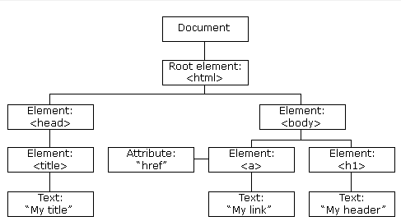
DOM Programming Interface
The HTML DOM is a standard object model and programming interface for HTML.
The HTML DOM model is constructed as a tree of Objects:

Slide 18
What is the HTML DOM?
The Document Object Model (DOM) is a platform and language-neutral interface that allows programs and scripts to dynamically access and update the content, structure, and style of a document.
The HTML DOM can be accessed with JavaScript (and with
other programming languages).
Notes:
so here question arise what is html dom- stands

Slide 19
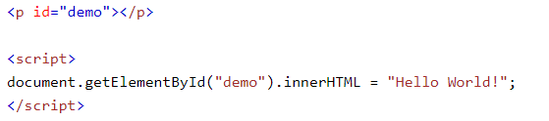
DOM Programming Interface
In the DOM, all HTML elements are defined as objects.
A property is a value that you can get or set.
A method is an action you can do.
This is method
This is property

Slide 20
getElementById Method
<img id=“myImage" src=“mountain.jpg">
<p id=“txt”> hello </p>
<script>
document.getElementById(“myImage").src ="river.jpg";
document.getElementById(“txt”).innerHTML = “Hey” ;
</script>

Slide 21

getElementById Method
Hello
Hey

Slide 22
getElementByClassName Method
<div class="example">First div element with class="example". </div> <div class="example">Second div element with class="example". </div> <p> Click the button to change the text of the first div element with class="example" (index 0). </p>
<button onclick="myFunction()">Try it</button>
<script> function myFunction() { var x = document.getElementsByClassName("example"); x[0].innerHTML = "Hello World!"; } </script>

Slide 23
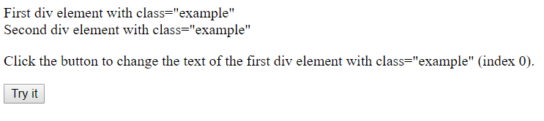
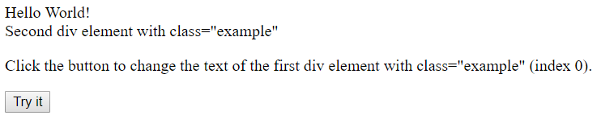
getElementByClassName Method

Slide 24
JavaScript
Notes:
Are you all familier with html. Which is hypertext markup language . So here question arise what a use of html in game development- answer is it provide structure to your page

Slide 25
getElementByTagName Method
<p>Click the button to change the text of this paragraph.</p>
<button onclick="myFunction()">Try it</button>
<script>
function myFunction() {
document.getElementsByTagName("P").innerHTML = "Hello World!";
}
</script>

Slide 26
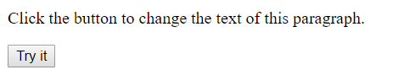

getElementByTagName Method

Slide 27
What is JavaScript?
JavaScript is a scripting language most often used for client-side web development.
Create interactive user interface in a web page (e.g., menu, pop-up alert, windows, etc.)
JavaScript (JS) is a programming language mostly used client-side to dynamically script web-pages, but often also server-side, using packages such as Node.js
Its various framework are Angular,React Native.

Slide 28
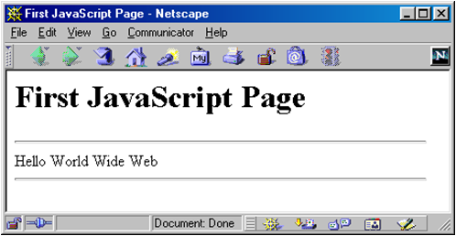
<script> Tag
<script> Tag
<html>
<head><title>First JavaScript Page</title></head>
<body>
<h1>First JavaScript Page</h1>
<script type="text/javascript">
document.write("<hr>");
document.write("Hello World Wide Web");
document.write("<hr>");
</script>
</body>
</html>

Slide 29
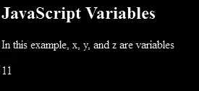
Variables and Variable Declaration
<p>In this example, x, y, and z are variables</p>
<p id="sum"></p>
<script>
var x = 5;
var y = 6;
var z = x + y;
document.getElementById("sum").innerHTML = z;
</script>

Slide 30
What are Identifiers?
# All JavaScript variables must be identified with unique names.
# These unique names are called identifiers.
# Contains only 'A' – 'Z', 'a' – 'z', '0' – '9', '_', '$'
# Case-sensitive

Slide 31
JavaScript Data Types
DATA TYPES
Primitive Data Types
Non-Primitive
Data Types
Number
String
Array
Object
Boolean

Slide 32
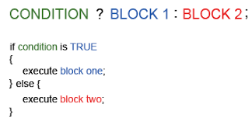
Conditional Statements
# "? :" ternary conditional statement
# “if” statement
# “if … else” statement
# “switch” statement

Slide 33
Operators
<Assignment>
<Arithmetic>
Operators are : +, -, *, /, %
Operators are : =, += ,-= ,*= ,/=
<Comparison>
Operators are : ==, !=, >, >=, <, <=, ===
<Logical>
Operators are: &&,||, !

Slide 34

Loop Statements and Control-Flow Statements
# “for” Loops
# “for/in” Loops
# “while” Loops
# “do … while” Loops
# “break” statement
# “continue” statement
# “return” statement

Slide 35
Functions
# Definition
Function is a block of code designed to perform a particular task.It is executed only when someone “invokes” the function(calls it).
# Example
var x = myFunction(4, 3);
function myFunction(a, b) {
return a * b; // Function returns the product of a and b
}
Output : 12

Slide 36
CANVAS

Slide 37
Canvas
#The canvas element is used to draw graphics, on the fly, via JavaScript.
#The canvas element is only a container for graphics. You must use JavaScript to actually draw the graphics.
#Canvas has several methods for drawing paths, boxes, circles, text, and adding images.
<canvas id="myCanvas" width="200“style=“border:1px solid black;” height="100"></canvas>
WILL GIVE

Slide 38
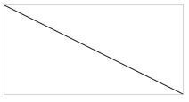
Things you can do in canvas
# Draw a Line
var c = document.getElementById("myCanvas");
var ctx = c.getContext("2d");
ctx.moveTo(0,0);
ctx.lineTo(200,100);
ctx.stroke();
WILL GIVE

Slide 39
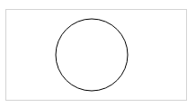
Draw
# Draw a Circle
var c = document.getElementById("myCanvas");
var ctx = c.getContext("2d");
ctx.beginPath();
ctx.arc(95,50,40,0,2*Math.PI);
ctx.stroke();
WILL GIVE

Slide 40

Draw
# Draw a Text
var c = document.getElementById("myCanvas");
var ctx = c.getContext("2d");
ctx.font = "30px Arial";
ctx.fillText("Hello World",10,50);
WILL GIVE

Slide 41

Gradient
# Draw Linear Gradient
var c = document.getElementById("myCanvas");
var ctx = c.getContext("2d");
// Create gradient
var grd = ctx.createLinearGradient(0,0,200,0);
grd.addColorStop(0,"red");
grd.addColorStop(1,"white");
// Fill with gradient
ctx.fillStyle = grd;
ctx.fillRect(10,10,150,80);
WILL GIVE

Slide 42
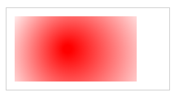
Gradient
# Draw Radial Gradient
var c = document.getElementById("myCanvas");
var ctx = c.getContext("2d");
// Create gradient
var grd = ctx.createLinearGradient(0,0,200,0);
grd.addColorStop(0,"red");
grd.addColorStop(1,"white");
// Fill with gradient
ctx.fillStyle = grd;
ctx.fillRect(10,10,150,80);
WILL GIVE
var grd = ctx.createRadialGradient(75,50,5,90,60,100);

